Slide 1

Network Programming in Python
Lecture 09
Python 网络编程
讲师: 胡伟通
School of Cyberspace
Hangzhou Dianzi University
2023-2024 Academic Year – 1st Semester
December 2023

Slide 2
「 Week 15 」
HTTP Clients

Slide 3

About this course
9.0 Introduction to the HTTP protocol
9.1 Python Client Libraries
9.2 Ports, Encryption, and Framing
9.3 HTTP Methods
9.4 Paths and Hosts
9.5 Status Codes
9.6 Caching and Validation
9.7 Content Encoding
9.8 Content Negotiation
9.9 Content Type
9.10 HTTP Authentication
9.11 Cookies
9.12 Connections, Keep-Alive, and httplib

Slide 4
9.0 Introduction to the HTTP protocol
Web page
Web pages are made up of objects
These objects can be HTML file, JPEG image, Java applet, audio file,…
The web page is composed of base HTML-file. Base HTML-file contains some reference objects.
Each object is addressed by a URL.
Example URL:
www.someschool.edu/someDept/pic.gif
host name
path name
Notes:
浏览器的web调试工具

Slide 5
HTTP overview
HTTP: hypertext transfer protocol
Web’s Application layer protocol client/server Model
client: Browser request, receive, display Web objects
server: The web server responds to the browser and sends the requested Objects to the browser.
HTTP 1.0: RFC 1945
HTTP 1.1: RFC 2068
HTTP 2.0: RFC 7540
HTTP request
PC running
IE
HTTP response
HTTP request
Server
running
Apache Web
server
HTTP response
Mac running
Navigator
Introduction to the http protocol version.
https://blog.csdn.net/u013967628/article/details/78521908
https://blog.csdn.net/Kangshuo2471781030/article/details/79253089

Slide 6
HTTP 1.0
Suppose the user clicks on an optional part of the screen with the mouse, the URL is http://www.hdu.edu.cn/news. The following is a more detailed description of several events that occur after the user clicks the mouse：
(1) The browser analyzes the URL of the hyperlink to the page.
(2) The browser requests the DNS to resolve the IP address of www.hdu.edu.cn.
(3) DNS resolves the IP address of the server to x.x.x.x.
(4) The browser establishes a TCP connection with the server (using port 80 on x.x.x.x).
(5) The browser issues a file fetch command: GET /news.
(6) The server at www.hdu.edu.cn gives a response, generates a page, and sends the page to the browser.
(7) The TCP connection is released.
(8) The browser displays all the text in the generated page.

Slide 7
HTTP request information
Two types of HTTP messages : request, response
HTTP request message:
ASCII (Human readable format)
Request line
(GET, POST,
HEAD commands)
GET /somedir/page.html HTTP/1.1
Host: www.someschool.edu
User-agent: Mozilla/4.0
Connection: close
Accept-language:cn
(extra carriage return（回车）, line feed（换行）)
header
lines
Carriage return,
line feed
Indicates the end of the message

Slide 8
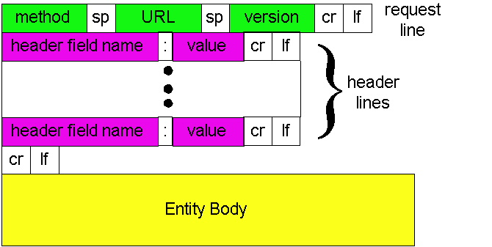
HTTP request message: universal format

Slide 9
Method types
HTTP/1.0
GET
POST
HEAD
For Query
HTTP/1.1
GET, POST, HEAD
PUT
uploads file in entity body to path specified in URL field
DELETE
deletes file specified in the URL field
OPTIONS
TRACE
CONNECT
HTTP 2 & HTTP 3:
https://mp.weixin.qq.com/s/_Sa3QSN8PnM61qMG_0gtSw

Slide 10
HTTP response message
status line
(protocol
status code
status phrase)
HTTP/1.1 200 OK
Connection: close
Date: Thu, 06 Aug 1998 12:00:15 GMT
Server: Apache/1.3.0 (Unix)
Last-Modified: Mon, 22 Jun 1998 …...
Content-Length: 6821
Content-Type: text/html
data data data data data ...
header
lines
data, e.g.,
requested
HTML file

Slide 11
HTTP response message - response status codes
In first line in server->client response message.
A few sample codes:
200 OK
request succeeded, requested object later in this message
301 Moved Permanently
requested object moved, new location specified later in this message (Location:)
400 Bad Request
request message not understood by server
404 Not Found
requested document not found on this server
505 HTTP Version Not Supported

Slide 12
Write a client using socket
See http_client.py
http_client.py url filename

Slide 13
9.1 Python Client Libraries
Python provides a number of third-party HTTP client libraries：
requests（based on urllib3）
urllib
Test site:
http://httpbin.org/
Available under Linux:
$ pip install gunicorn httpbin requests
$ gunicorn httpbin:app
The difference between urllib, urllib2, urllib3, httplib, httplib2, request in python: https://blog.csdn.net/permike/article/details/52437492

Slide 14
9.2 Ports, Encryption, and Framing
HTTP protocol uses port 80 by default.
HTTPS uses TLS to encrypt the HTTP protocol.
Default port 443
Allow authentication of the server (can also support authentication of the client)
Request response (HTTP 1.1 does not currently allow a second request to be sent before a request response is received)

Slide 15
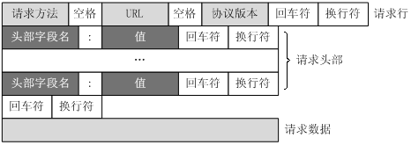
9.2 Ports, Encryption, and Framing
Framing
Request and response line CRLF
Header line CRLFCRLF
Message body (request and response)
Content-Length:
Transfer-Encoding: chunked
Connection: close

Slide 16
9.3 HTTP Methods
GET: Get the resource by request URI
POST: for adding new content
PUT: used to modify a content
DELETE: delete a content
CONNECT: used for proxy transmission, such as using SSL
OPTIONS: Ask what methods can be performed
TRACE: for remote diagnostic server
HEAD: Similar to GET, but does not return body information, used to check if the object exists, and to get the object's metadata
http://www.cnblogs.com/yin-jingyu/archive/2011/08/01/2123548.html

Slide 17
9.4 Paths and Hosts
Earlier version
GET /html/rfc7230
One server to build multiple web servers
GET /html/rfc7230 HTTP/1.1
Host: tools.ietf.org

Slide 18
9.5 Status Codes
The HTTP response code, also known as the status code, reflects the state of the web server processing the HTTP request. The HTTP response code consists of 3 digits, where the first digit defines the type of response code：
1XX-Information class, indicating that a web browser request is received and is being processed further.
2XX-Successful, indicating that the user request was received correctly, understanding and processing, for example: 200 OK.
3XX-Redirection, indicating that the request was not successful, the client must take further action.
4XX- Client Error, indicating that the client submitted the request has an error. For example: 404 NOT Found, meaning that the document referenced in the request does not exist.
5XX-Server Error means that the server cannot complete the processing of the request: eg 500.

Slide 19
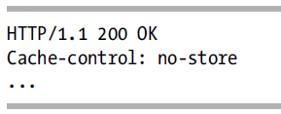
9.6 Caching and Validation
In order to prevent clients from frequently requesting duplicate resources and improve efficiency, HTTP provides multiple mechanisms (RFC7231 and RFC7232)：
Cache mechanism
Problem: If the request path is the same, will this returns the same document?
Rely on other HTTP headers
Vary Options（Host、Accept-Encoding、Cookie and so on）
Disable caching

Slide 20
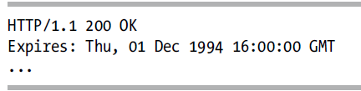
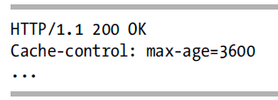
9.6 Caching and Validation
Allow caching for a certain time
Expired settings
Method 1： specify time （ Client time may be inaccurate ）
Method 2：specify cache time

Slide 21
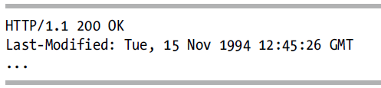
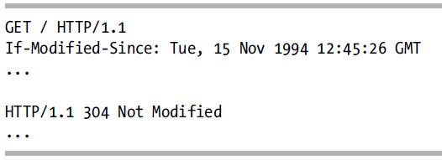
9.6 Caching and Validation
Method 1
Give the request file modification date and time
When the server answers：
When the client requests twice ：If-Modified-Since

Slide 22
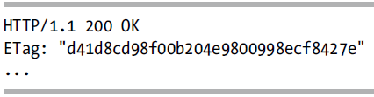
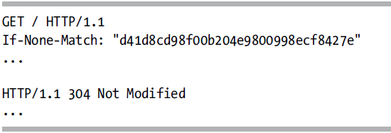
9.6 Caching and Validation
Method 2:
Give each version a different resource ID （ Check code, UUID, etc.）
When the client requests twice ：If-None-Match

Slide 23
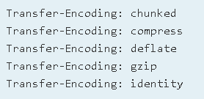
9.7 Content Encoding
Transfer-Encoding and Content-Encoding
Transfer-Encoding： The encoding used by the HTTP protocol to transfer files
Content-Encoding： The encoding used by the transmitted file content itself
Transfer-Encoding：
https://developer.mozilla.org/zh-CN/docs/Web/HTTP/Headers/Transfer-Encoding
https://developer.mozilla.org/zh-CN/docs/Web/HTTP/Headers/Content-Encoding
Difference：https://blog.csdn.net/pud_zha/article/details/17247943
https://yq.aliyun.com/ziliao/546827

Slide 24
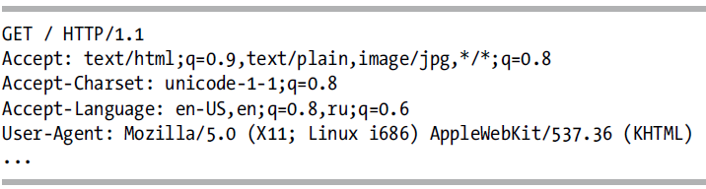
9.8 Content Negotiation
Negotiate the file types, encoding types, languages, and character sets supported by the browser
Content-Encoding
Requests support the Accept header through the Session
https://developer.mozilla.org/zh-CN/docs/Web/HTTP/Headers/Transfer-Encoding
https://developer.mozilla.org/zh-CN/docs/Web/HTTP/Headers/Content-Encoding
Difference：https://blog.csdn.net/pud_zha/article/details/17247943
https://yq.aliyun.com/ziliao/546827

Slide 25
9.9 Content Type
Response：Content-Type， MIME
Content-Type: text/html; charset=utf-8
Check the semicolon and decode it with the corresponding code set
Many libraries need to split the field to decode.
The Request library supports decoding using this code set.

Slide 26
9.10 HTTP Authentication
Used to confirm the identity of the machine or user who sent the request
401 Not Authorized
HTTP provides Basic Auth

Slide 27
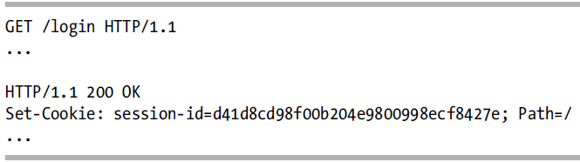
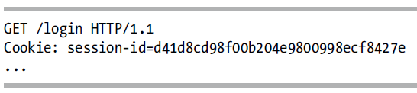
9.11 Cookies
Websites generally tend to use their own methods to authenticate customers.
HTTP is a stateless service, and the server wants the client to be able to save some information.
Cookie is a key-value pair. "Cookie": “name=test; age=18",
session

Slide 28
9.12 Connections, Keep-Alive, and httplib
HTTP1.0 version. One connection to transfer one object.
Connection：close
HTTP1.1 and later. One connection to transfer multiple objects.
Connection: keep-alive
urllib does not support connection multiplexing. One can use http.client directly.
Requests support connection multiplexing.

Slide 29
Thank you!

